Slide 1


Welcome you all
String & Numeric Functions
Day - 3
D.Sakthivel
Assistant Professor & Trainer,
KGiSL Micro College
KGiSL Campus, Coimbatore – 641 035.

Slide 2
Day 3
MySQL String Functions
MySQL Numeric Functions
Limit
Offset

Slide 3
MySQL String Functions
Function | Description
ASCII | Returns the ASCII value for the specific character
CHARACTER_LENGTH | Returns the length of a string (in characters)
CONCAT | Adds two or more expressions together
CONCAT_WS | Adds two or more expressions together with a separator
FORMAT | Formats a number to a format like "#,###,###.##", rounded to a specified number of decimal places
INSERT | Inserts a string within a string at the specified position and for a certain number of characters
INSTR | Returns the position of the first occurrence of a string in another string
LCASE | Converts a string to lower-case
LEFT | Extracts a number of characters from a string (starting from left)
LENGTH | Returns the length of a string (in bytes)
LOWER | Converts a string to lower-case

Slide 4
MySQL String Functions
Function | Description
LPAD | Left-pads a string with another string, to a certain length
LTRIM | Removes leading spaces from a string
MID | Extracts a substring from a string (starting at any position)
POSITION | Returns the position of the first occurrence of a substring in a string
REPEAT | Repeats a string as many times as specified
REPLACE | Replaces all occurrences of a substring within a string, with a new substring
REVERSE | Reverses a string and returns the result
RIGHT | Extracts a number of characters from a string (starting from right)
RPAD | Right-pads a string with another string, to a certain length
RTRIM | Removes trailing spaces from a string
STRCMP | Compares two strings
SUBSTR | Extracts a substring from a string (starting at any position)
SUBSTRING | Extracts a substring from a string (starting at any position)

Slide 5
MySQL String Functions
Function | Description
TRIM | Removes leading and trailing spaces from a string
UCASE | Converts a string to upper-case
UPPER | Converts a string to upper-case

Slide 6
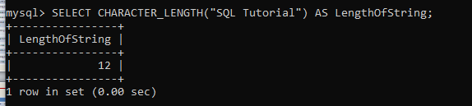
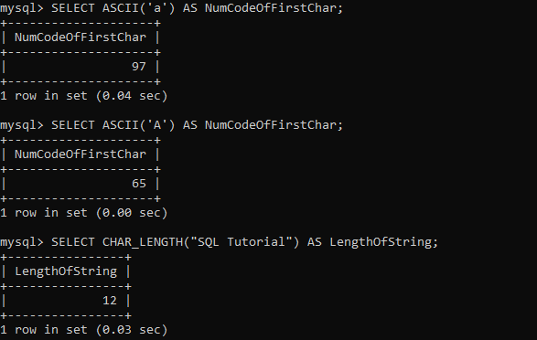
MySQL String Functions

Slide 7
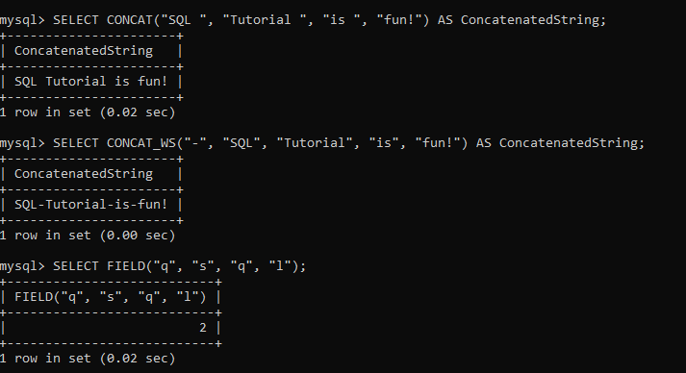
MySQL String Functions

Slide 8
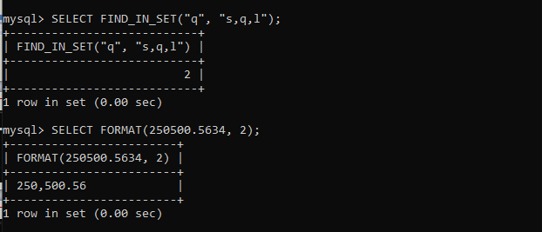
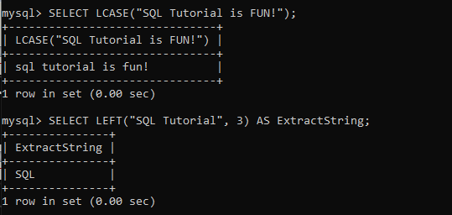
MySQL String Functions

Slide 9
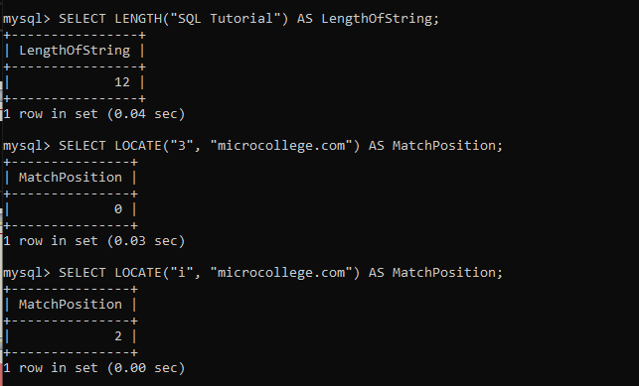
MySQL String Functions

Slide 10
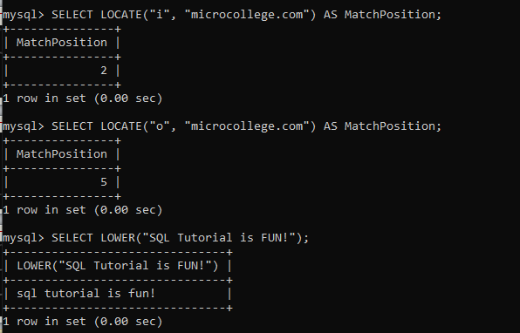
MySQL String Functions

Slide 11
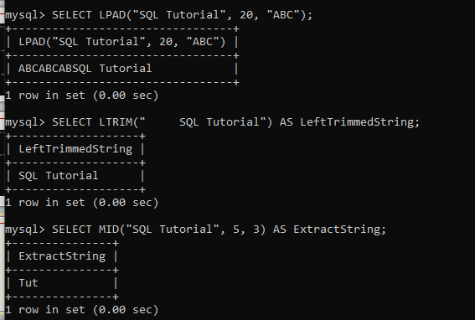
MySQL String Functions

Slide 12
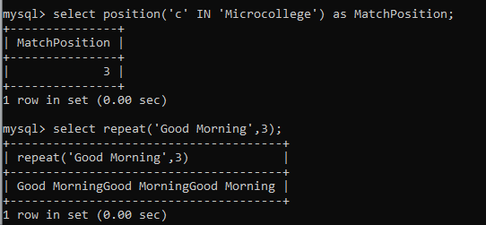
MySQL String Functions

Slide 13
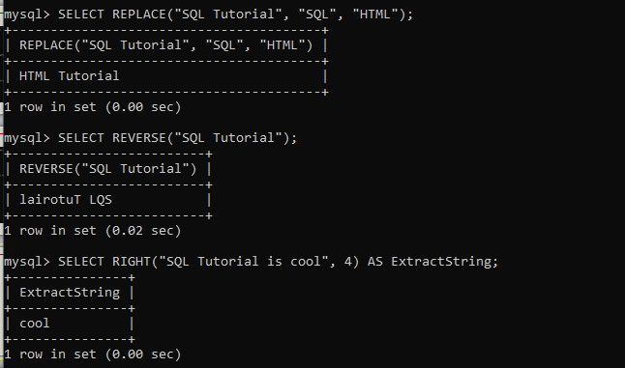
MySQL String Functions

Slide 14
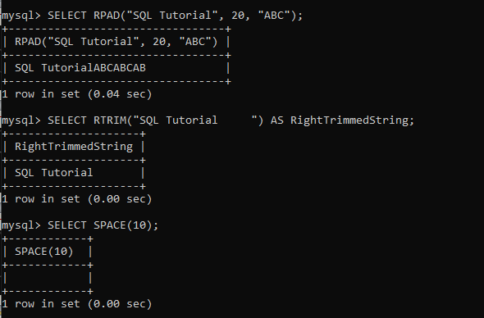
MySQL String Functions

Slide 15
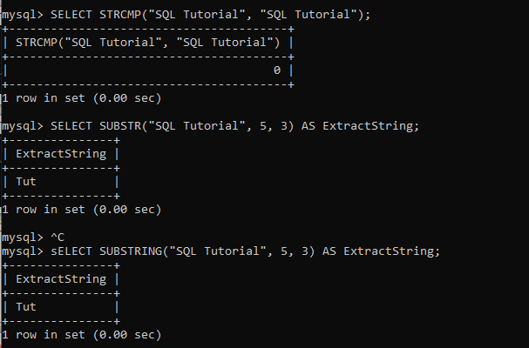
MySQL String Functions

Slide 16
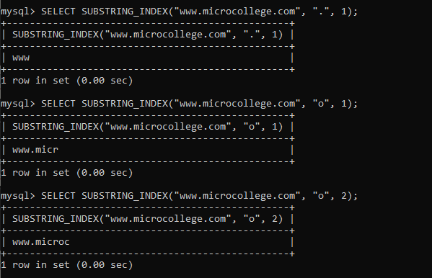
MySQL String Functions

Slide 17
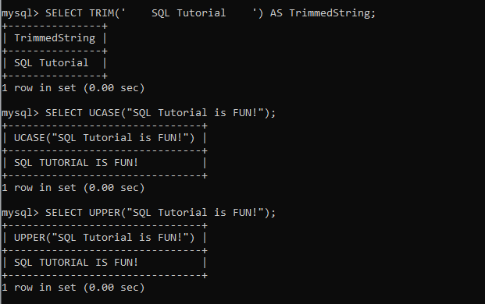
MySQL String Functions

Slide 18
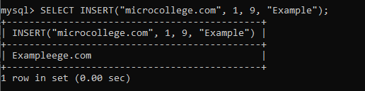
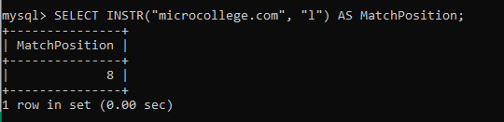
MySQL String Functions

Slide 19
MySQL Numeric Functions
Function | Description
ABS | Returns the absolute value of a number
ACOS | Returns the arc cosine of a number
ASIN | Returns the arc sine of a number
ATAN | Returns the arc tangent of one or two numbers
ATAN2 | Returns the arc tangent of two numbers
AVG | Returns the average value of an expression
CEIL | Returns the smallest integer value that is >= to a number
CEILING | Returns the smallest integer value that is >= to a number

Slide 20
MySQL Numeric Functions
Function | Description
COS | Returns the cosine of a number
COT | Returns the cotangent of a number
COUNT | Returns the number of records returned by a select query
DEGREES | Converts a value in radians to degrees
DIV | Used for integer division
EXP | Returns e raised to the power of a specified number
FLOOR | Returns the largest integer value that is <= to a number
GREATEST | Returns the greatest value of the list of arguments
LEAST | Returns the smallest value of the list of arguments

Slide 21
MySQL Numeric Functions
Function | Description
LN | Returns the natural logarithm of a number
LOG | Returns the natural logarithm of a number, or the logarithm of a number to a specified base
LOG10 | Returns the natural logarithm of a number to base 10
LOG2 | Returns the natural logarithm of a number to base 2
MAX | Returns the maximum value in a set of values
MIN | Returns the minimum value in a set of values
MOD | Returns the remainder of a number divided by another number
PI | Returns the value of PI
POW | Returns the value of a number raised to the power of another number

Slide 22
MySQL Numeric Functions
Function | Description
POWER | Returns the value of a number raised to the power of another number
RADIANS | Converts a degree value into radians
RAND | Returns a random number
ROUND | Rounds a number to a specified number of decimal places
SIGN | Returns the sign of a number
SIN | Returns the sine of a number
SQRT | Returns the square root of a number
SUM | Calculates the sum of a set of values
TAN | Returns the tangent of a number
TRUNCATE | Truncates a number to the specified number of decimal places

Slide 23
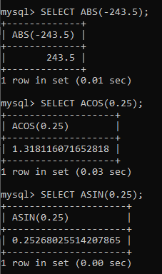
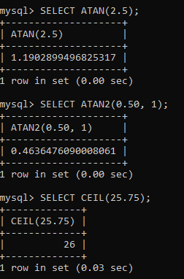
MySQL Numeric Functions

Slide 24
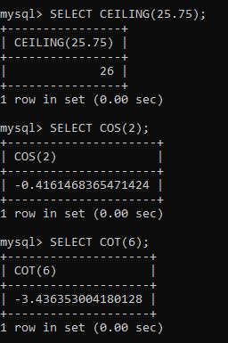
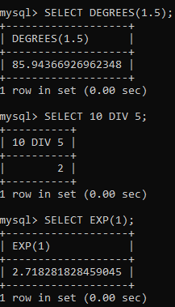
MySQL Numeric Functions

Slide 25
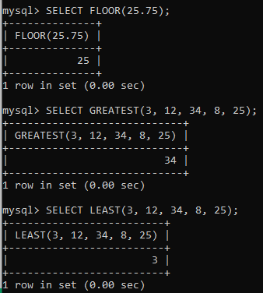
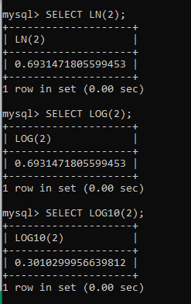
MySQL Numeric Functions

Slide 26
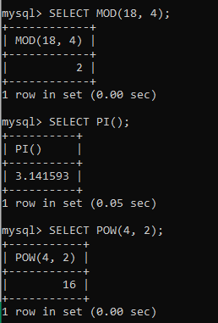
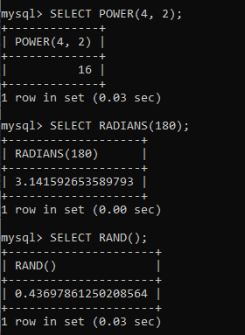
MySQL Numeric Functions

Slide 27
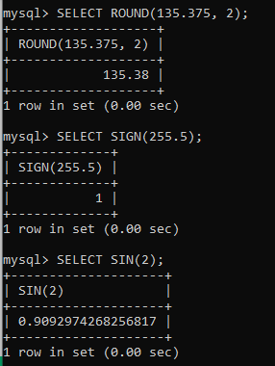
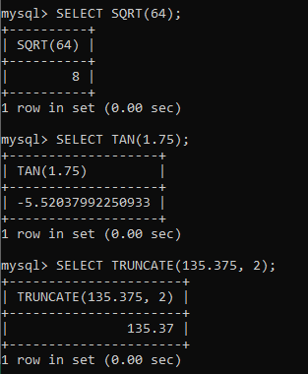
MySQL Numeric Functions

Slide 28
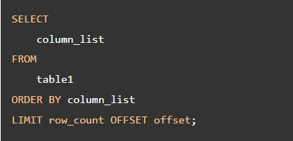
MySQL Limit and Offset:
To limit the number of rows returned by a select statement, you use the LIMIT and OFFSET clauses.
In this syntax:
The LIMIT row_count determines the number of rows (row_count) returned by the query.
MySQL Offset is used to specify from which row we want the data to retrieve.

Slide 29
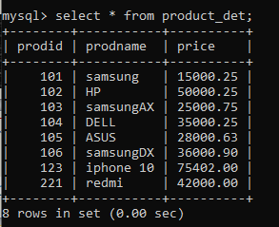
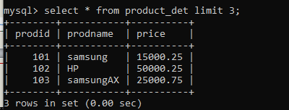

Slide 30
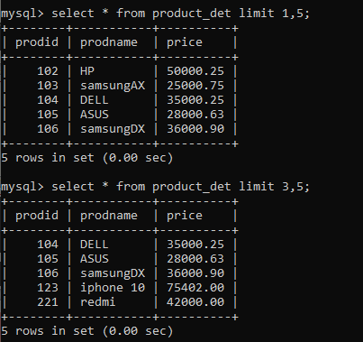

Slide 31
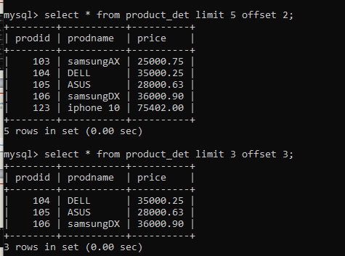
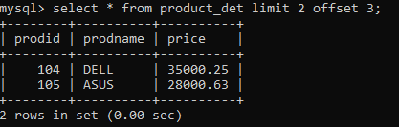

Slide 32
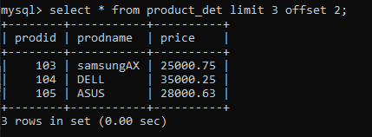

Slide 33



Thank You

